Slide 1
Kirana App – Project Management Overview
Team: Devinity
Project Manager: Muhammad Arib
Faculty Lead: Ms. Maryam Feroze Duration: 2 Aug – 9 Oct 2025

Slide 2



Project Overview
Kirana App – Bridging Local Commerce & Communication
A web-based platform combining chat and marketplace features.
Designed for local vendors in Karachi to connect with nearby customers.
Emphasizes simplicity, and Urdu/English support.
Aims to digitize small-scale commerce and empower informal businesses.

Slide 3
Project Life Cycle
01.
02.
03.
04.
05.
06.
07.
Requirement Analysis
Planning
Design
Development
Testing
Deployment
Maintenance
Identified user needs and defined project scope.
Outlined milestones, resources, and risk management.
Created Flow Diagram and Figma prototype
Developed chat, profile, and marketplace modules; integrated Firebase backend.
fixed bugs and improved usability
Deployed MVP to live environment
Monitor Feedback

Slide 4
Project Objectives & Success Criteria
Objectives
Functional MVP in 10 Weeks
Integrate Chat + Marketplace
Simplified Store On-boarding and profile creation
Conduct UAT
Success Criteria
MVP deployed by 9 October
Passes UAT with minimal critical errors
All Deliverables Submitted On time
On-board at least 20 Shop owner and Customer satisfaction rate > 60%

Slide 5
Project Scope
Out-of-Scope Features:
In-Scope Features (MVP):
Mobile App
General
Native mobile applications (iOS/Android).
A responsive, mobile-first web app with Urdu and English language support.
User Management
Payment Gateway
Secure user registration via phone/email and profile management
Scope
Integrated online payment gateways.
Chat Features:
Private messaging, with encryption, for user and shop with individual control for editing (30 min window) and deleting message
Logistics
Bazaar Features
In-app delivery or logistics services.
Simple seller profile creation and onboarding, and user review system

Slide 6
Project Timeline (Phases)
Phase 1
Phase 2
Phase 3
Phase 4
Phase 5
Planning & Requirements
Design & Prototype
Development
Testing &
Deployment
Project Closure
(Aug 2–14)
(Aug 15–27)
(Aug 27–Sep 24)
(Sep 25–Oct 5)
(Oct 6–9)

Slide 7
Roles & Responsibilities
Project Roles
QA & Testing
Designers
PM / Developer
Business Analyst
Marketing
Haris
Arib
Arib
Haider
Moin
Moin
Riyan
Riyan
Haider
Haris

Slide 8
Work Breakdown Structure (WBS)
Kirana App
Project Planning & Initiation
Designing
Development
Testing & QA
Deployment & Closure
Finalize Project Charter & Plan
UI/UX Design (Figma)
Chat & Bazaar Module
UAT
Deploy to Live Server
Scope Statement & WBS Draft
User Flow
Authentication System
Manual
Testing
Prepare Presentation
Effort Estimation
Database Schema
Role Based Profile
Bug Fixes
Lesson Learned

Slide 9
Key Project Meetings
6th Aug
3rd Sep
1st Oct
Risk Identification, Categorization, and Initial Risk Ranking
Scope Revision & Success Criteria Alignment
Functional Requirements & Effort Estimation
1
2
3
4
5
Goal
6
3rd Aug
20th Aug
24th Sep
Project Initiation & Initial Documentation Finalization
WBS Development (First Draft)
Integration Planning, Network diagram, and updated WBS

Slide 10
PM Framework Waterfall Model
Requirement Gathering
Planning
Design
Development
Testing
Deployment

Slide 11
How We Identified Risk
Standard Checklist
Historical Data
Team Experience
40%
15%
45%
We referred to Boehm’s Top 10 Software Risks and other project management checklists to ensure no typical risks were overlooked.
We reviewed past cases of local apps in Pakistan to identify common causes of failure, such as unrealistic timelines or integration issues
We relied on our understanding of the local Karachi market and technical challenges to brainstorm potential problems early.

Slide 12
Risk Management
Task | Likelihood | Impact | Mitigation
Personnel shortfalls | Above Avg 3.6 | Above Avg 3.2 | Cross-train, share knowledge
Unrealistic schedule | Above Avg 3.8 | High 4 | Focus on MVP only
Wrong functions | Above Avg 3.2 | Avg 2.8 | Validate via SRS and Project Plan
Technical integration | High 4 | Avg 3 | Define clear API contracts and Test each Component
External service failure | Avg 2.6 | Above Avg 3.8 | Choose reliable tools + fallback plans
Low Risk
Medium Risk
High Risk

Slide 13
Project Monitoring & Control how we tracked progress
Weekly Meetings
We held weekly team meetings every Wednesday to ensure smooth flow
GitHub
Used GitHub for code version control.
WhatsApp
Used WhatsApp for day to day updates, Project Tracking, and sharing Ideas with the group

Slide 14
QA / Testing
Manual Testing : Verified module interactions (Chat, Bazaar, Authentication) and ensured smooth data flow between Pages.
User Acceptance Testing:
11 users validated usability and functionality; feedback was logged and reviewed by the team.
Bug Fixing & Final Review: Resolved major issues, performed regression testing, and confirmed system readiness for deployment.
Post–bug-fix validation confirmed the app met defined scope, performance, and quality standards The application is therefore considered stable and ready for MVP release.

Slide 15
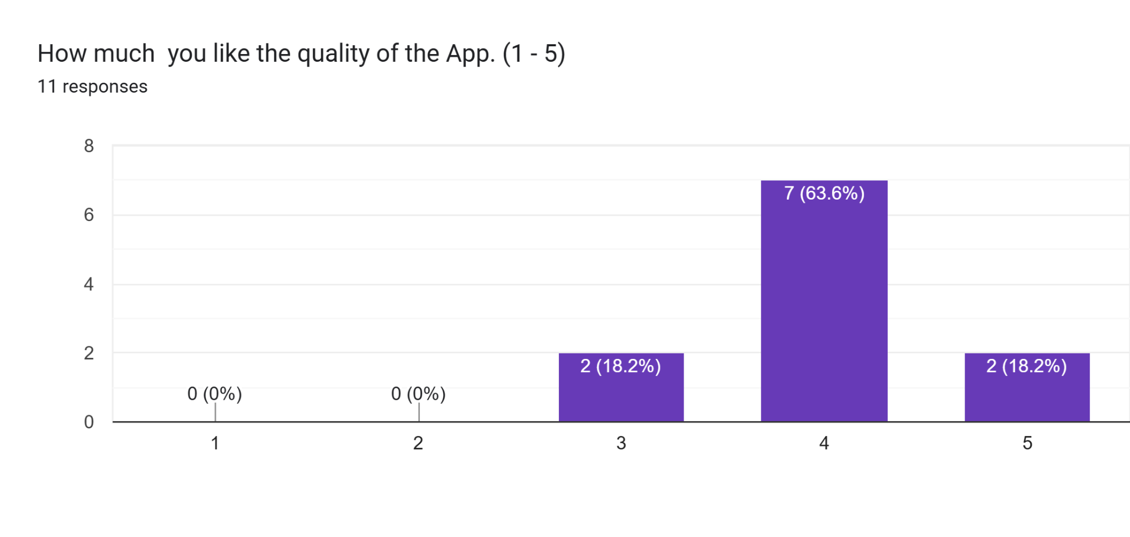
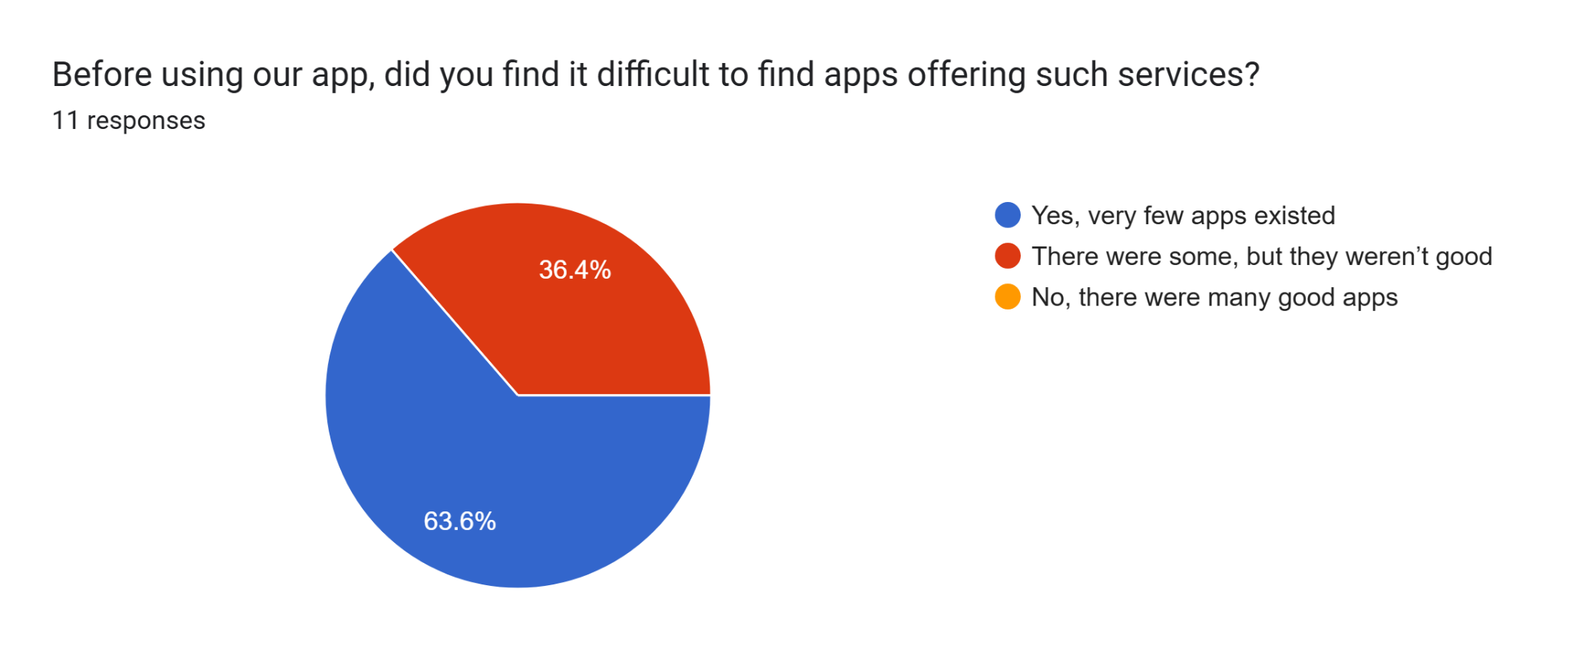
User Feedback
Our success criterion was to achieve a user satisfaction rate above 60%, and we successfully reached approximately 80%.
The User Feedback also shows that Kirana is filling a gap in market that has been left unidentified

Slide 16
Project Closure
Project Information
Date of Completion: October 9, 2025
Project Duration: August – October 2025
Project Type: Web Application
Project Deliverables
Fully functional Chat & Bazaar platform with authentication
Complete project documentation and reports
Final Presentation and project showcase
Benefits
Promotes digital visibility for small local vendors
Simplifies buyer–seller communication
Serves as a scalable base for future marketplace features
Kirana App
Control In Place
Weekly team progress meetings
Centralized Documentation management via GitHub
Defined scope and risk control process

Slide 17
Lessons Learned
Importance of Planning: Early estimation and structured scheduling help maintain progress and avoid burnout.
Communication Matters: Weekly meetings, regular work updates, and shared repositories ensured alignment and minimized rework.
Technical Preparedness: Familiarizing with Firebase and real-time databases early improved development speed and reliability.
Scope Management: Clear boundaries prevented scope creep and kept the team focused on core objectives.
Testing before Deployment: Continuous testing significantly improves outcomes
Dependence on AI models: We should rely less on AI-generated content and thoroughly proofread and edit the documents produced, so we won't need to make numerous updates later.

Slide 18
Thank You

